Slide 1
LENDING CLUB CASE STUDY SUBMISSION
Group Members: Mohammed Irshad Hussain / Avesh Anil Mishra

Slide 2
Lending Club to identify the significant drivers of loan default
Company brief:
Lending club is a peer to peer lending company and is the largest online loan marketplace, facilitating personal loans, business loans, and financing of medical procedures. Borrowers can easily access lower interest rate loans through a fast online interface.
Analysis objective:
Lending Club aims to identify those significant drivers (features which are strong indicators of default) of loan default and observe patterns which indicate if a borrower is likely to default
Types of potential business decisions:
Loan accepted: If the company approves the loan, there are 3 possible scenarios described below:
i) Fully paid: Applicant has fully paid the loan (the principal and the interest rate)
ii) Current: Applicant is in the process of paying the instalments, i.e. the tenure of the loan is not yet completed. These candidates are not labelled as 'defaulted’.
iii) Charged-off: Applicant has not paid the instalments in due time for a long period of time, i.e. he/she has defaulted on the loan
Loan rejected: The company had rejected the loan (because the candidate does not meet their requirements etc.). Since the loan was rejected, there is no transactional history of those applicants with the company and so this data is not available with the company (and thus in this dataset)
Data source available:
1. Loans data – contains information about features of the borrowers and the loan that were disbursed by Lending Club in the past

Slide 3
Overall analysis pipeline
Data Wrangling – Part 1
Handling missing values (by dropping columns with missing % more than 7% )
Dropping columns with no analysis value (i.e columns with only 1 value, columns that are significant post approval of the loan, etc.)
Data Wrangling – Part 2
Validating certain internal rules of the data capture (eg: checking if there are cases where funded amount > listed loan amount)
Analysis
Univariate Analysis (Understanding all the attributes one at a time for loans that are paid vs defaulted loans)
Bivariate Analysis (Understanding attributes in pairs for loans that are paid vs defaulted loans)
Correcting column types
Creating more derived features from the existing features
Converting all text columns to uppercase, removing whitespaces and unwanted characters
Binning continuous data
Removing outliers (like borrowers with abnormally high incomes)

Slide 4


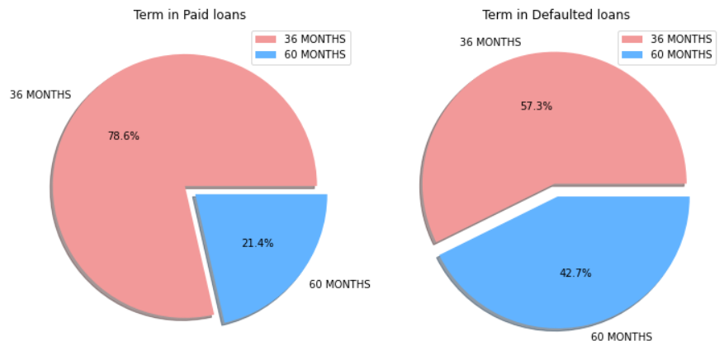

Long-term loans tend to default more
Observation:
It is clearly observed that loans that have been completely ‘paid-off’ have a larger proportion of short term loans (3 years) when compared to loans that have ‘defaulted’
Insight:
This is potentially observed because longer repayment periods are accompanied with costlier loans as borrowers need to repay a larger sum over a long time
Plot 1: Comparison of Loan periods in ‘paid loans’ vs ‘defaulted loans’

Slide 5
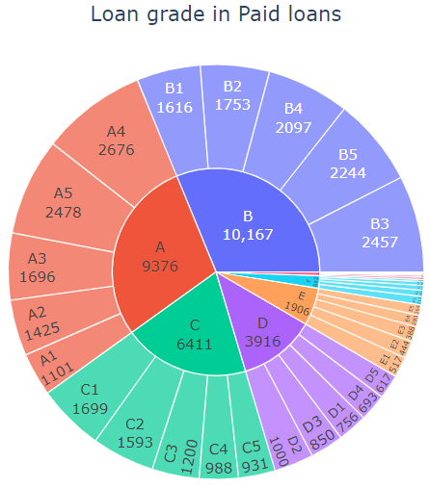
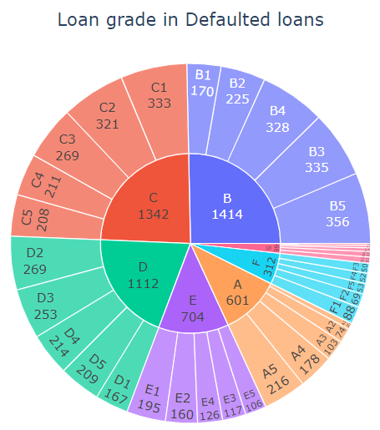
Lower loan grades are associated with higher defaults
Observation:
Lower loan grades like (grade C and below) are more prominent in defaulted loans where ‘paid-off’ loans have a better loan grade
Insight:
Borrowers are assigned a loan grade by Lending club and hence a better loan grade is accompanied with benefits like lower interest rates, lower installments, etc., hence we observe a higher repayment when loan grades are better (grade A or grade B)
Plot 2: Comparison of Loan grades (and sub grades) in ‘paid loans’ vs ‘defaulted loans’

Slide 6
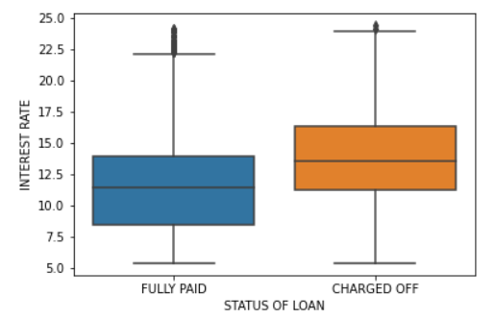
Higher interest rate is a common feature among defaulters
Observation:
Loan defaulters seem to be paying back credit which charges a higher interest rate (sometimes as high as 15%) when compared to borrowers who have paid back fully (median interest rate < 12%)
Insight:
This is expected because higher interest rate is mostly associated with lower grade loans and hence increasing net installment per month and the total sum repaid (principle + interest)
Plot 3: Comparison of interest rates in ‘paid loans’ vs ‘defaulted loans’

Slide 7
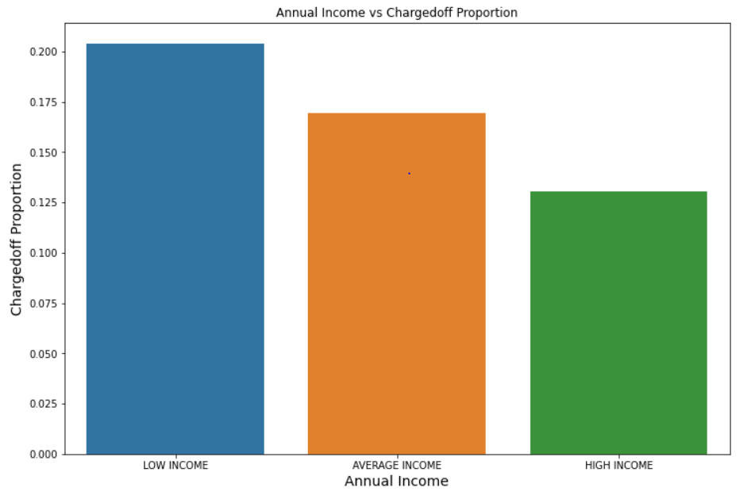
Higher Annual Income has less number of charged-off loans
Observation:
It is observed that there is a high probability for Individuals with high annual income fully paying the loan amount, at the same time, the proportion of defaults is higher for the ones with low annual income.
Insight:
This is expected because higher annual income may help in repaying the loans back as compared to low annual income so the number of loan defaults are higher for individuals with low annual income.

Slide 8
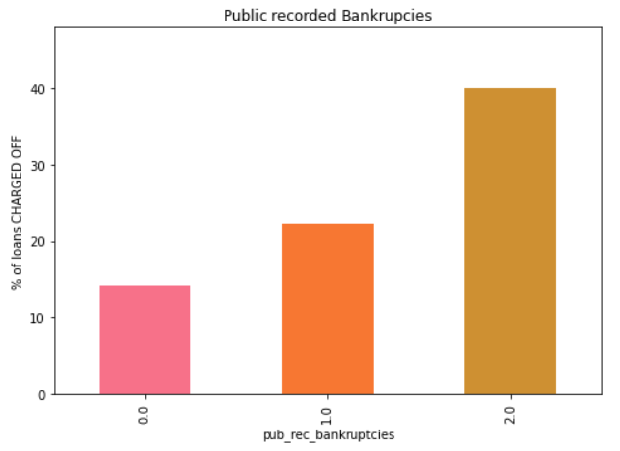
High chances of defaults if borrower has been recorded bankrupt
Observation:
It is observed that there is a high probability for Individuals with (1 or more than 1) recorded no. of bankruptcies to default the loan repayments.
Insight:
This can be a very important parameter in order to access the borrower and his/her repayment capabilities at the same time reducing the risk of defaults.

Slide 9
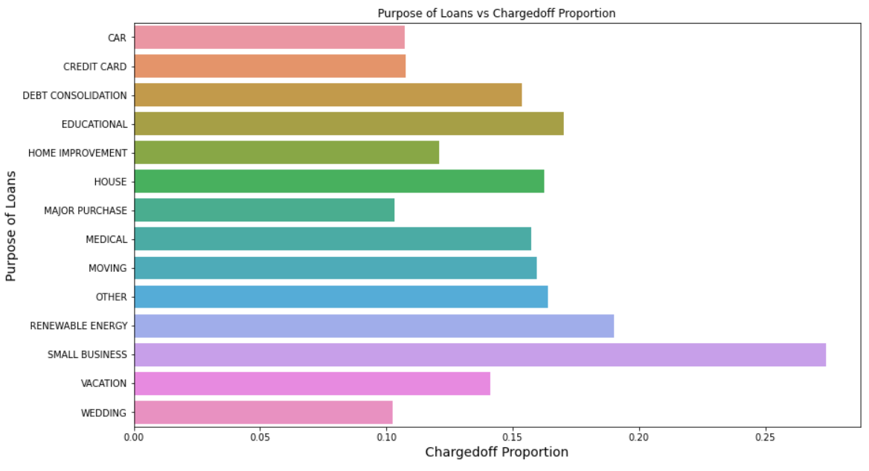
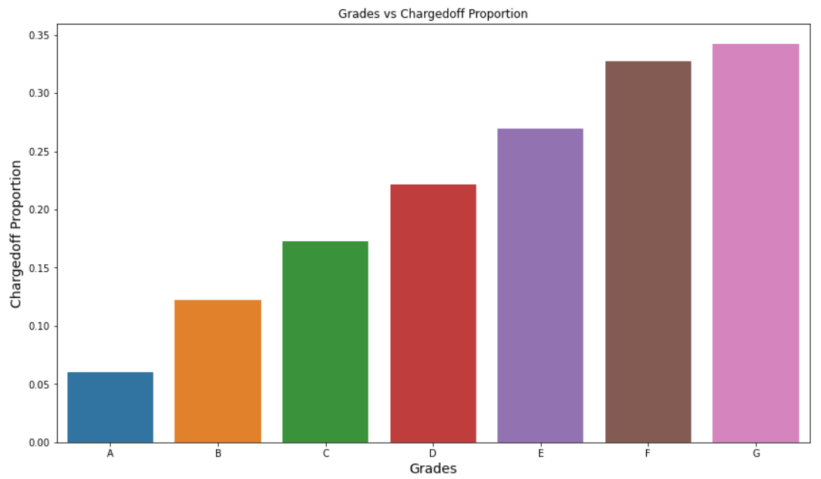
Loan purpose and Grades are Important parameters for charged off loans
Observation:
It is observed that there is a high probability for defaults in certain purposes, say 1. Small Business 2. Renewable Energy 3. Education and the lower grades highly contribute to the default rates.
Insight:
The company should make through decision based on grades and purpose before offering the loan amount to the borrowers.

Slide 10
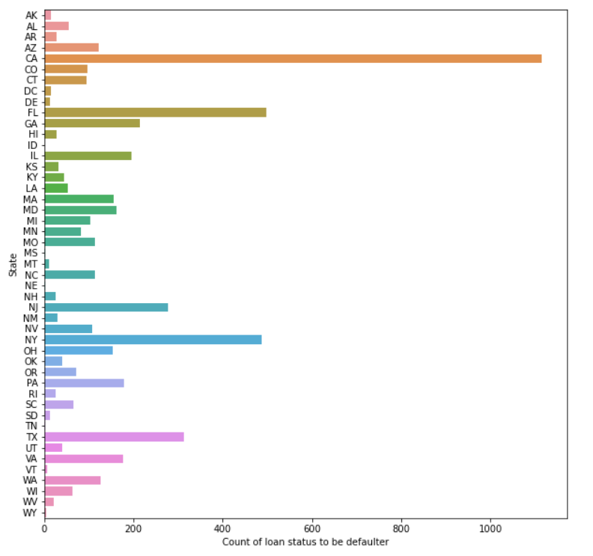
Certain States tends to attract more no. of defaults
Observation:
It is observed that there is a high probability for defaults in certain states, for example: CA and NY. Where as defaults are at its lowest in some other states, example: ID this can be because the no. of borrowers can be more in CA/NY and less in ID.
Insight:
The no. of defaults are most in the state of CA, which can be the result of increased number of borrowers in that state.

Slide 11

SUMMARY & CONCLUSIONS
Following are some key features to be studied before disbursing a loan and hence, are important drivers of default:
Duration (or tenure) of loan – Long term loans are associated with higher default, hence loan duration to be negotiated with borrower
Loan Grade – Higher quality loan grades are associated with lower default, hence priority to be given to borrowers of grade A or B
Annual Income – Low annual income is directly proportional to more no. of defaults, hence a threshold income level should be maintained before offering loans.
Public recorded bankruptcies – Higher number of recorded bankruptcy for a borrower leads to higher chances of defaults, Hence loans should be approved for the borrowers with minimum number of bankruptcies.
Purpose of loan – There is also a relationship between loan purpose and the no, of charged-off loans, certain loan purposes tends to attract more no. of defaults than usual, therefore loans should be provided based on proper understanding of the purpose and whether the business will be profitable for the borrower or not, which intern define whether the borrower will be able to repay the loan or not.
State – Charged-off loans in certain states are over the roof whereas in certain states they are at their lowest.

